Slide 1
File formats

Slide 2
File Formats
Files created by software applications are stored so that they can be used again later.
Each application stores its files in the most efficient way.
This leads to different file formats for different applications
File formats are indicated by the extensions used in the file name

Slide 3
Proprietary formats
Proprietary formats are those owned by commercial companies and used within their software.
File extension | Type of file | Meaning
.doc or .docx | Word processed document | Microsoft Word Document
.xls or .xlsx
.ppt or .pptx
.fla
.wma
.psd

Slide 4
Open formats
Used by a variety of software applications and can be used to transfer data between applications.
File Extension | Type of file | Meaning
.aac |  | Advanced audio encoding
.rtf
.csv
.exe
.txt
.pdf
.mp3
.aiff
.wav

Slide 5
Questions
Why do applications save files with a file extension?
Explain what is meant by a proprietary file format and an open source format
Identify two formats that could be used to store notes made by an estate agent as they interview people who want to rent a house.

Slide 6
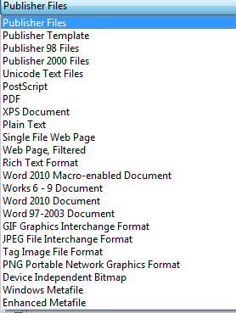
Choosing the appropriate format
Many applications can save files in many different format. A DTP application such as Publisher will by preference save its files in its own proprietary format as this is the most efficient way to do so. However it is possible to save in many other formats

